Slide 1
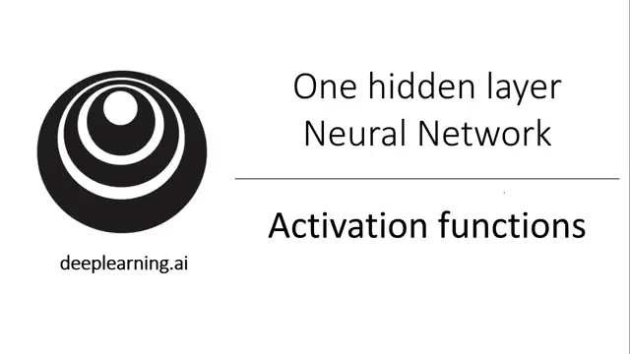
Activation functions

Slide 2
Activation functions
$$x_{1}$$
$$x_{2}$$
$$\hat{y}$$
$$x_{3}$$
Given x:
$$z^{\left[1\right]}=W^{\left[1\right]}x+b^{\left[1\right]}$$
$$a^{\left[1\right]}=σ(z^{\left[1\right]})$$
$$z^{\left[2\right]}=W^{\left[2\right]}a^{\left[1\right]}+b^{\left[2\right]}$$
$$a^{\left[2\right]}=σ(z^{\left[2\right]})$$

Slide 3
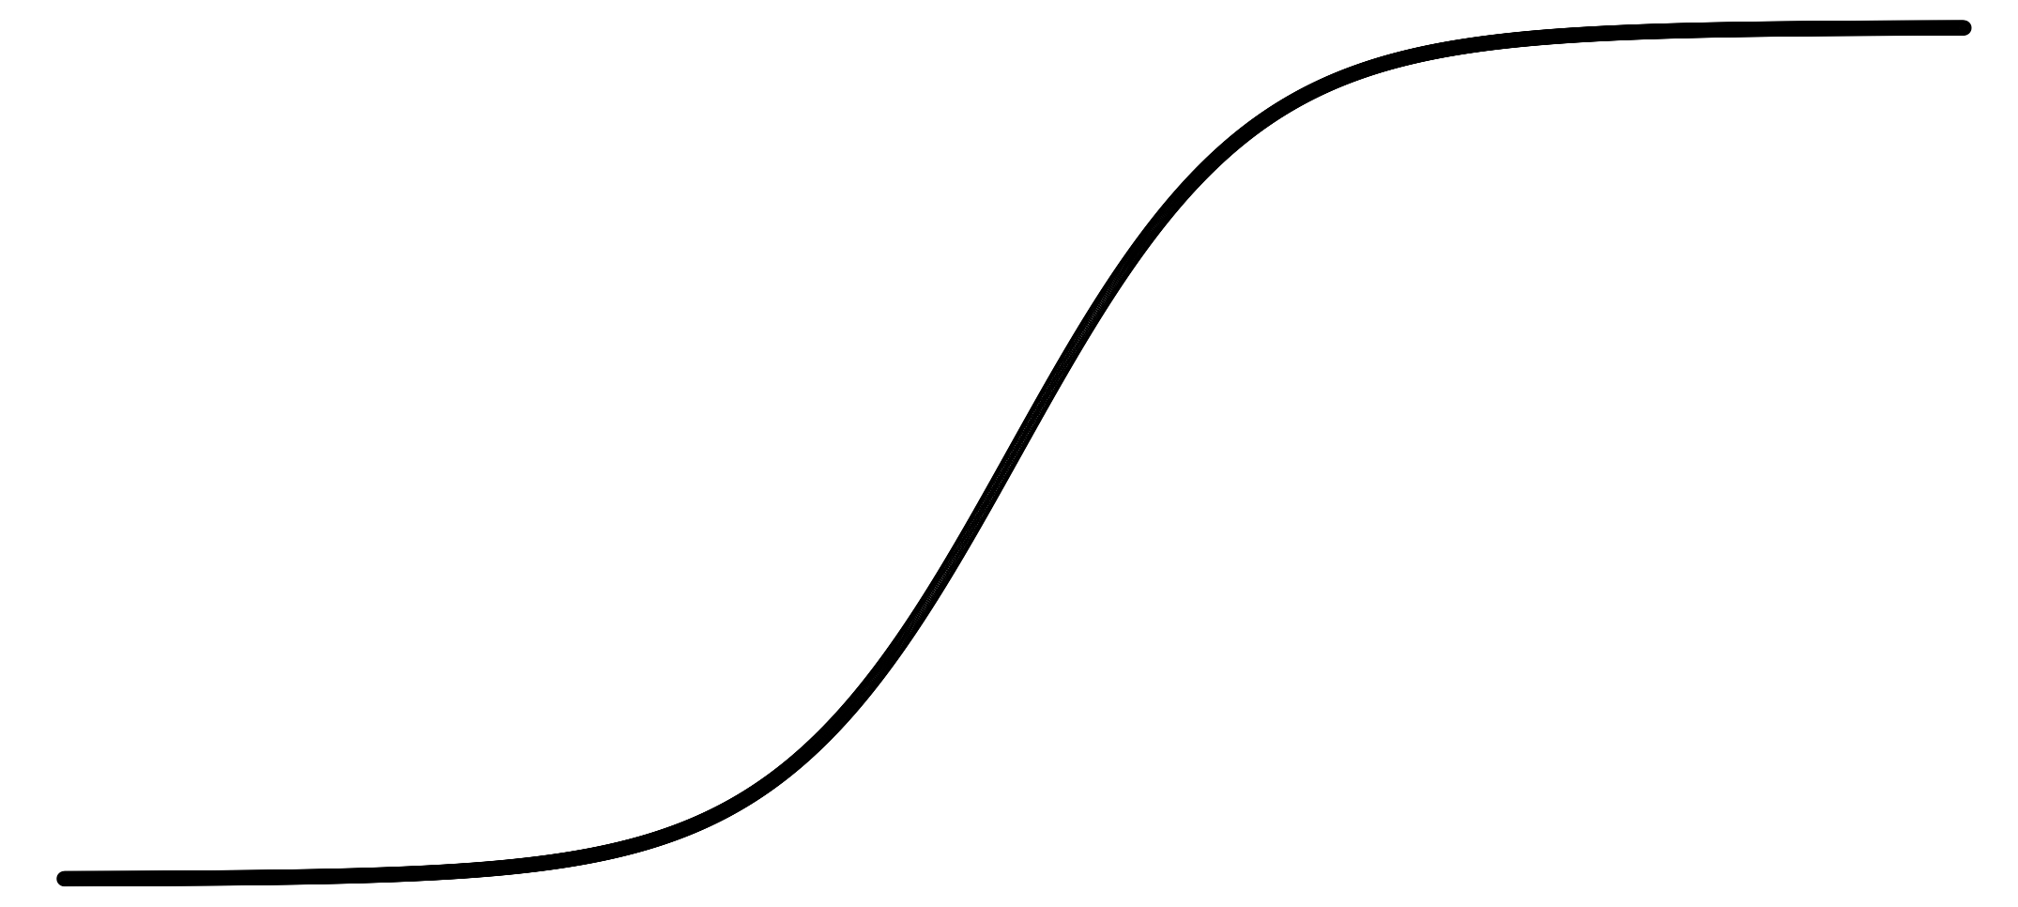
Pros and cons of activation functions
a
a
x
z
$$a= \frac{1}{1+e^{−z}}$$
sigmoid:
a
a
z
z

Slide 4
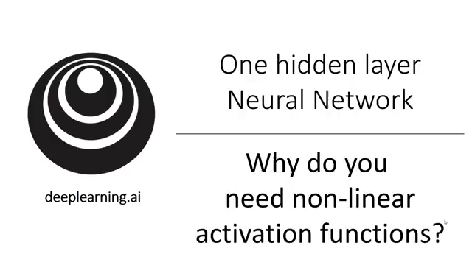
Why do you need non-linear activation functions?

Slide 5
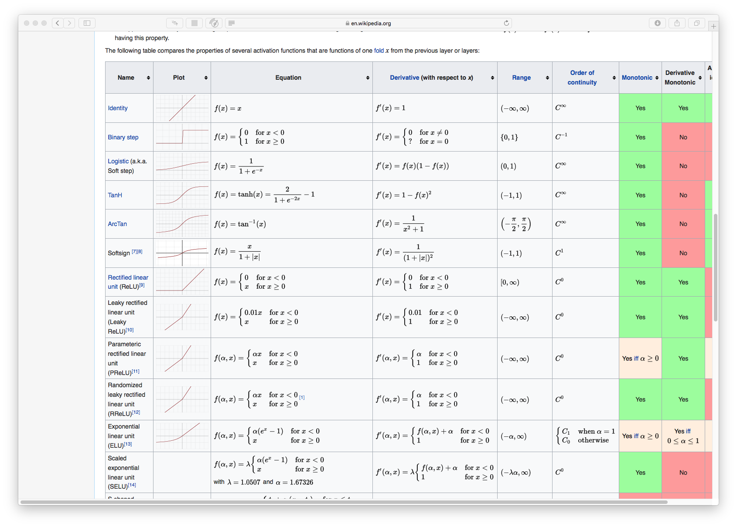
Overview Activation functions

Slide 6
Activation function
$$x_{1}$$
$$x_{2}$$
$$\hat{y}$$
$$x_{3}$$
Given x:
$$z^{\left[1\right]}=W^{\left[1\right]}x+b^{\left[1\right]}$$
$$a^{\left[1\right]}=g^{[1]}(z^{\left[1\right]})$$
$$z^{\left[2\right]}=W^{\left[2\right]}a^{\left[1\right]}+b^{\left[2\right]}$$
$$a^{\left[2\right]}=g^{[2]}(z^{\left[2\right]})$$

